Slide 1


Contextual Embeddings Can Distinguish Homonymy from
Polysemy in a Human-Like Way
Kyra Wilson¹, Alec Marantz^{1,2}
¹NYU Abu Dhabi, ²NYU Linguistics and Psychology
kew6086@nyu.edu
Notes:
Hello my name is Kyra Wilson and today I’m going to be talking about how we can use contextualized word embeddings to analyze human language processing, specifically in the case of polysemes and homonyms.

Slide 2
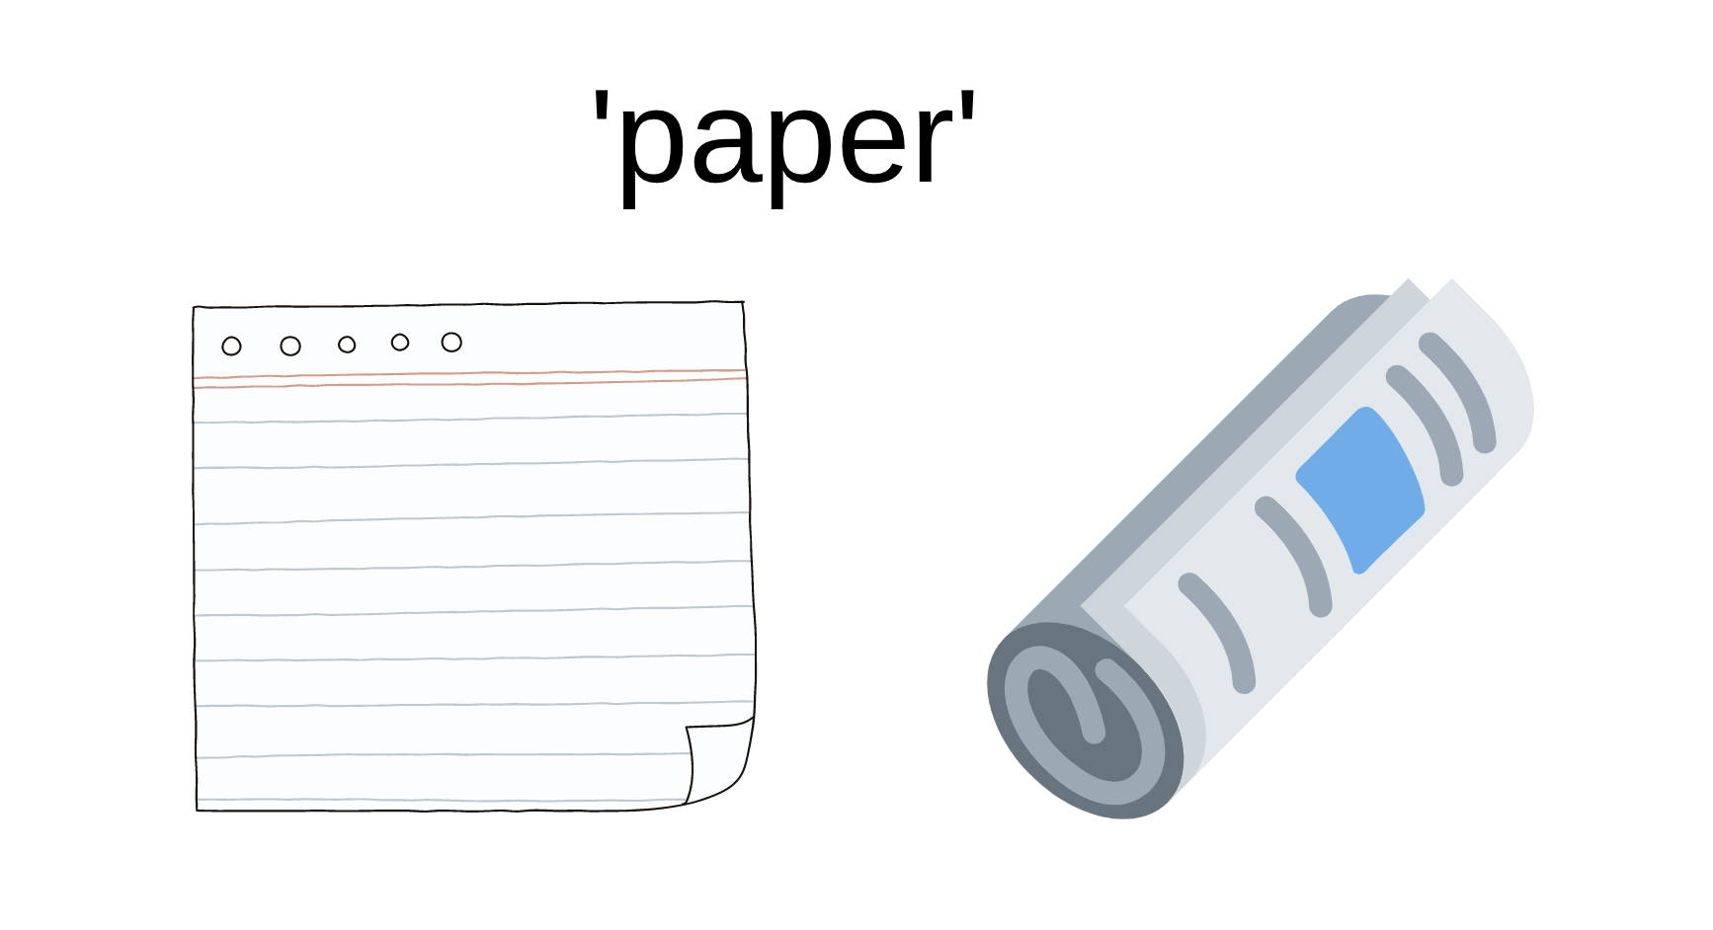
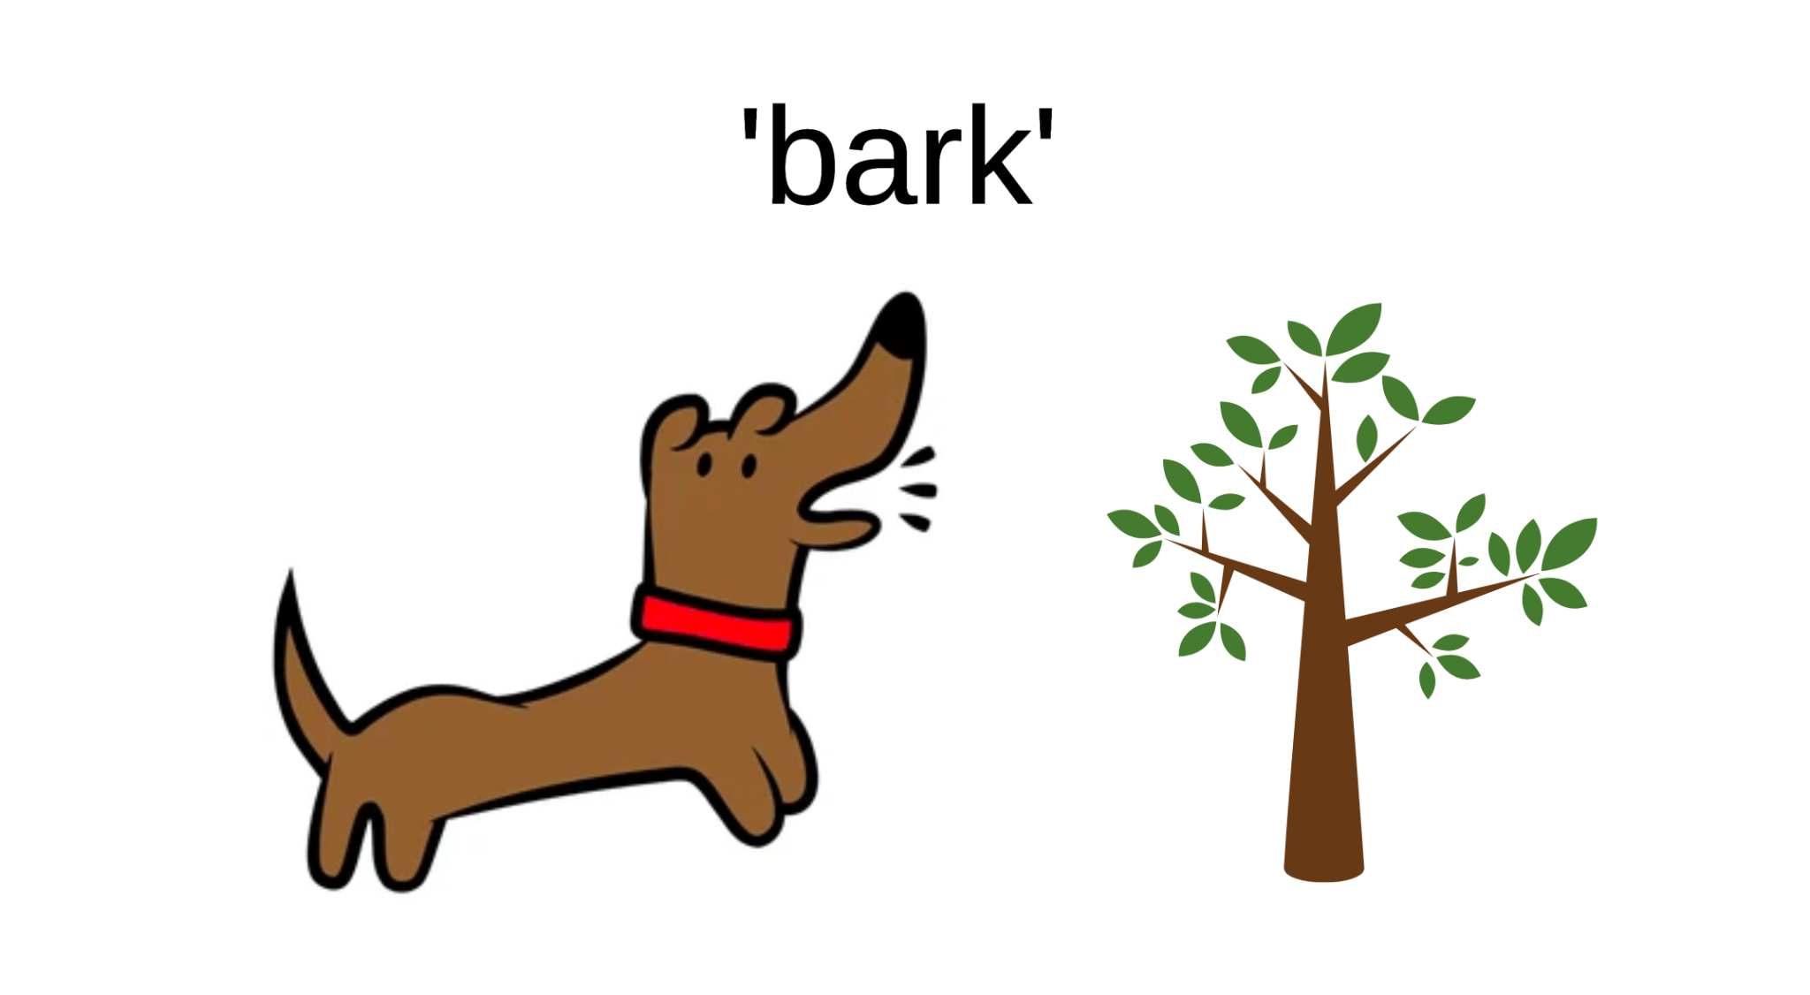
What are homonymy and polysemy?
POLYSEMY
HOMONYMY
Notes:
So first things first, I will answer the question “what are homonyms and polysemes?” These are both kinds of lexical ambiguities, where a word has a single spelling but multiple meanings.
In the case of polysemy, the meanings are related and referred to as “senses”. So the word “paper” for example, has a meaning like a sheet you write something on, but it could also mean something you read to get the news. The referent in these two cases is different, but they are similar and share some semantic core, so in this case we would say that “paper” is polysemous and has multiple related senses.
Homonyms, on the other hand, have meanings that are unrelated. “Bark” for example can mean the sound a dog makes or it can mean the outer covering a tree. These two meanings are not related to each other at all, so “bark” would be a homonym.
Typically, the way these two can be distinguished in a dictionary is by their organization–word meanings correspond to dictionary headings, while senses are the entries beneath a heading.

Slide 3
How do humans process ambiguous words?
POLYSEMY
HOMONYMY
?
Reaction Time
Reaction Time
Number of Senses
Number of Meanings
Notes:
So now you might be wondering, if there are different kinds of ambiguities, does that matter in how we process language? And unfortunately there is not a straightforward answer to that.
Many psycholinguistics experiments have found that being polysemous or having multiple related senses can make a word easier to recognize. This has been observed in lexical decision experiments where participants are asked to indicate whether they recognize a word or not, and then faster reaction times of polysemous words over unambiguous words are assumed to correspond to easier processing.
Experiments have had less consistent results with homonyms. Some studies find that having multiple unrelated meanings can actually slow reaction time, or they do not find an effect of meanings at all. Further work needs to be done to truly understand the effect of unrelated meanings on word recognition.

Slide 4
The issues with replicability
The resources used to quantify polysemy and homonymy are made by humans and could be biased
Studies are inconsistent in which resources are used and what distinctions are made between polysemy and homonymy
To understand the effect of ambiguity on human language processing, we must quantify ambiguity in way that has as little human intervention as possible and can be used across studies
Notes:
One challenge to researching this phenomenon is that there is no gold standard resource that can be used to quantify homonymy and polysemy. Typically resources like dictionaries or WordNet are used, but there are limitations to using these sources.
Additionally, studies are not consistent about which resources are used or what distinctions are made between homophony and polysemy. This makes it difficult to establish replicable effects across experiments.
Because of these limitations, we would like to find some way to quantify homophony and polysemy that is not reliant on resources created by lexicographers and has clear criteria as to what distinguishes a related sense from an unrelated meaning.

Slide 5
Q1: How can contextualized word embeddings be used to quantify ambiguity?
Q2: Do our measures perform as well as traditional ones in predicting human behavior?
Notes:
One way that we propose this can be done is by using contextualized word embeddings. Unlike static word embeddings, contextualized word embeddings have representations that vary depending on the words in the surrounding context. This means that for an ambiguous word, there are likely to be multiple distinct embeddings corresponding to usages in different contexts. Our aims in this study were first to propose a way to utilize this in order to quantify homophony and polysemy, and then test this measure’s ability to predict human behavior.

Slide 6

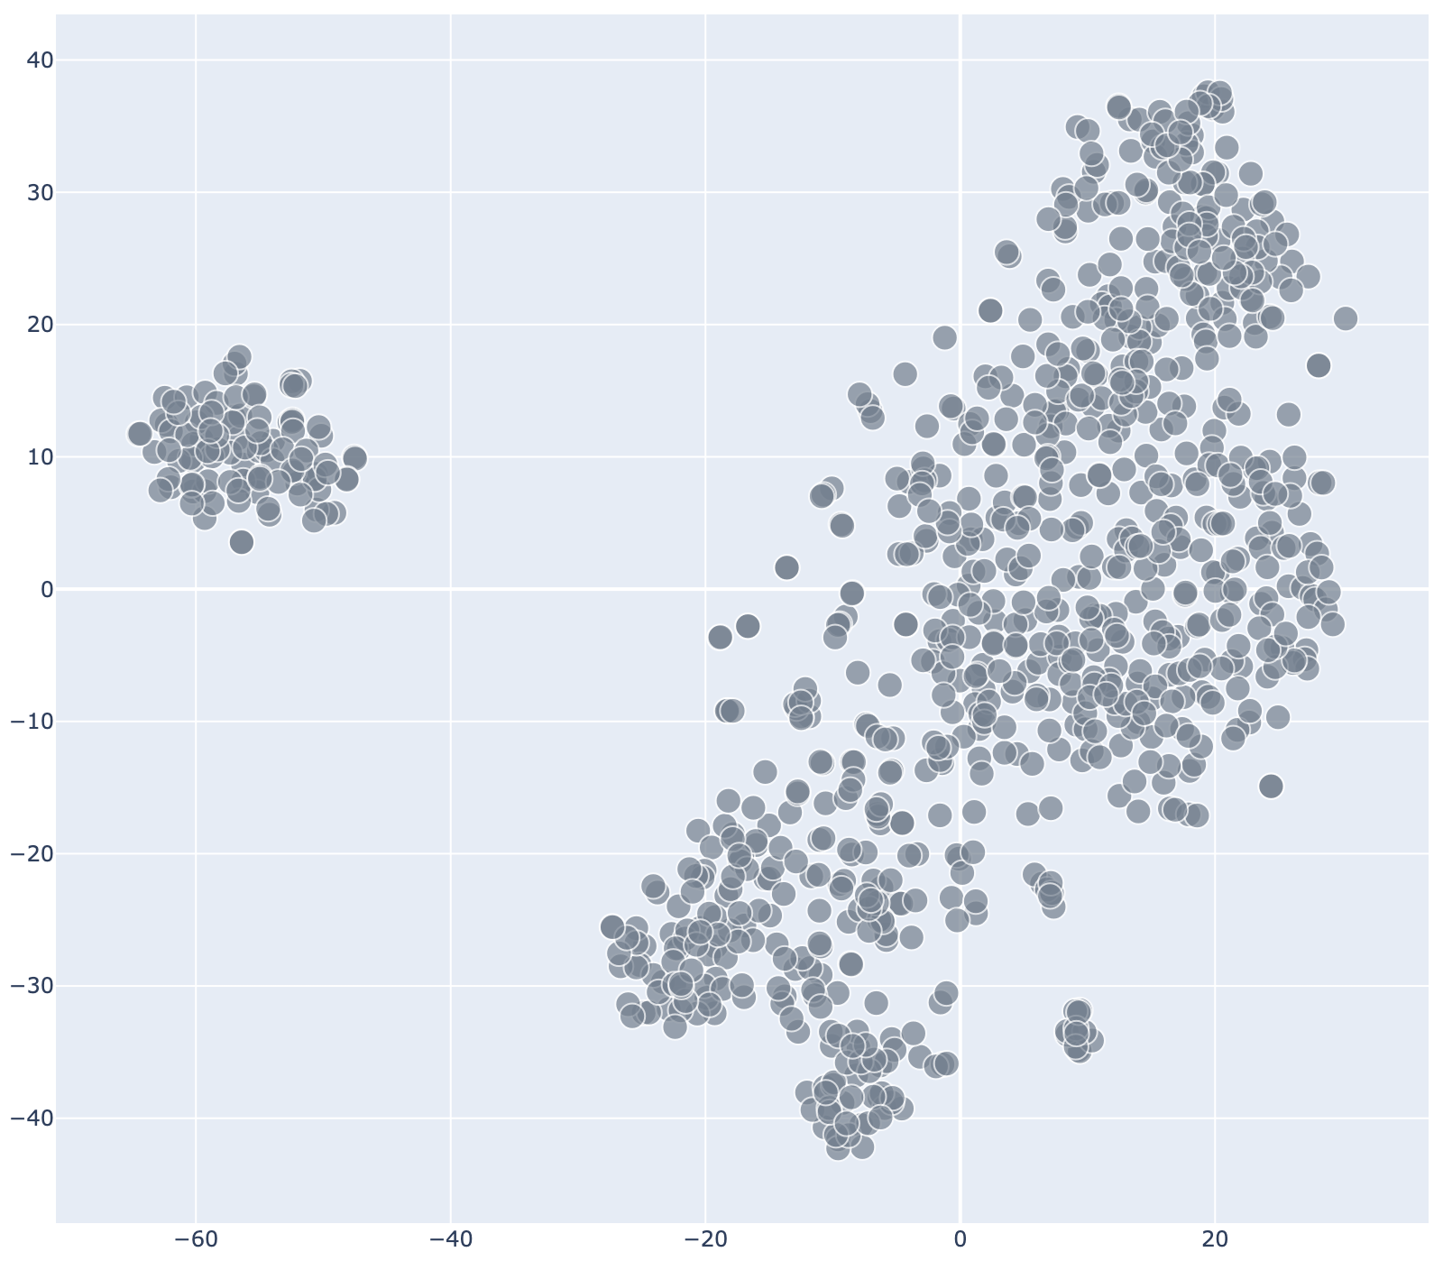
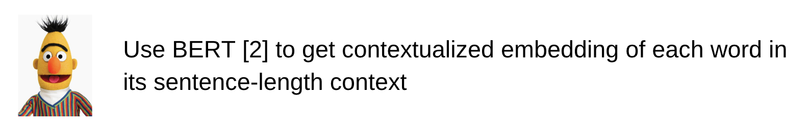
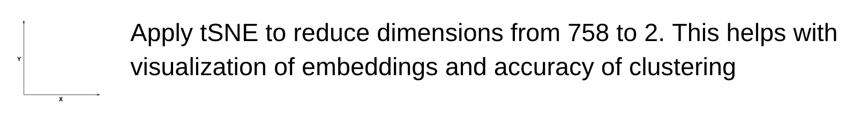
Counting the number of senses
‘tent’
[1] Emily Reif, Ann Yuan, Martin Wattenberg, Fernanda B Viegas, Andy Coenen, Adam Pearce, and Been Kim. 2019. Visualizing and measuring the geometry of BERT. Advances in Neural Information Processing Systems, 32.
[2] Jacob Devlin, Ming-Wei Chang, Kenton Lee, and Kristina Toutanova. 2019. BERT: Pre-training of deep bidirectional transformers for language understanding. In Proceedings of the 2019 Conference of the North American Chapter of the Association for Computational Linguistics: Human Language Technologies, Volume 1 (Long and Short Papers), pages 4171–4186, Minneapolis, Minnesota. Association for Computational Linguistics.
Notes:
The first step to using contextualized embeddings to quantify the number of senses a word has is getting them in a variety of contexts. We sampled 1,000 occurrences of each word of interest and their context sentences from English Wikipedia.
Next, we used BERT to produce embeddings for each of the sampled sentences, and then extracted the embedding corresponding to the ambiguous word of interest. This singular embedding was used for all further analysis.
Once we had the embeddings, we used tSNE to reduce the dimensions of the embedding from 758 to 2. With fewer dimensions, we are able to visualize the embeddings in space as can be seen in the figure here for the word ‘tent’.
And as you can see, we are already able to see the emergence of a couple clusters in space which correspond to groups of embeddings which are more similar to each other, and dissimilar from other groups. Because there is a clear clustering, we are able to apply a clustering algorithm to count the number of clusters (or senses) that exist.

Slide 7
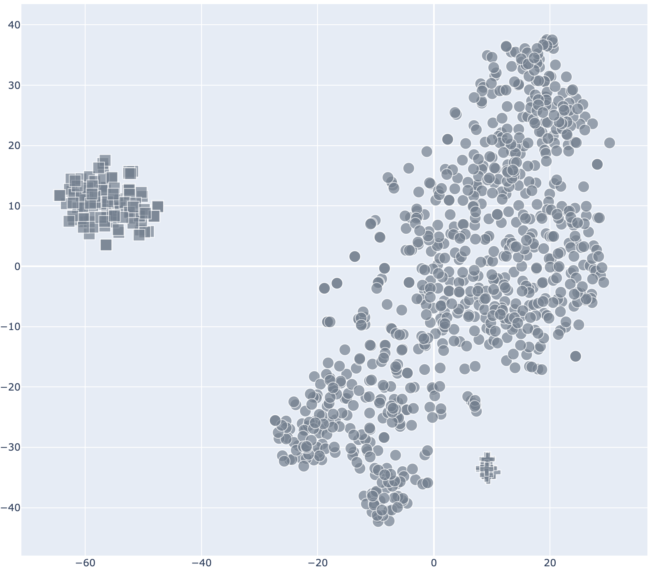

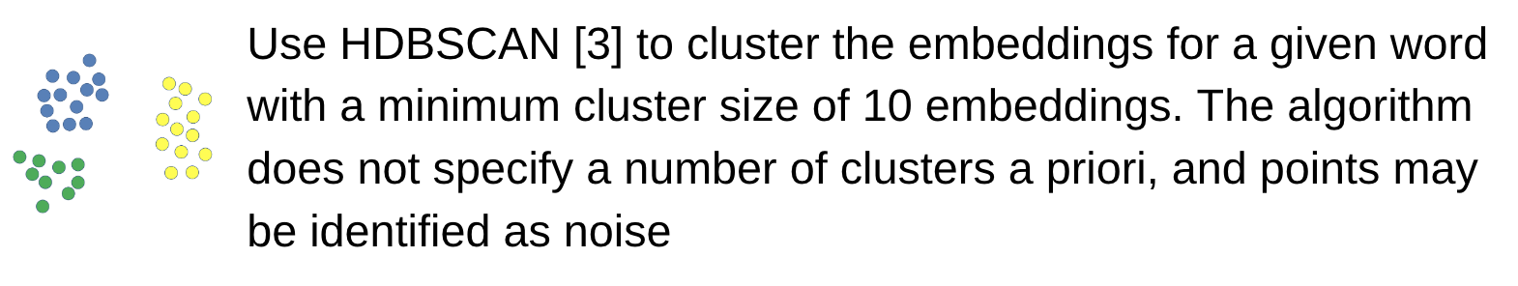


Counting the number of senses
‘tent’
A feature on the north side of the park, known as The Tent…
The second stage was an air-conditioned tent where…
The party is considered to be something of a big tent party…
[3] Ricardo JGB Campello, Davoud Moulavi, and Jörg Sander. 2013. Density-based clustering based on hierarchical density estimates. In Pacific-Asia conference on knowledge discovery and data mining, pages 160–172. Springer.
Notes:
The clustering algorithm we use is HDBSCAN. This works for our purposes for two reasons–first the number of clusters does not need to be specified a priori, and secondly it can identify points as noise in addition to assigning cluster membership. Because language is very flexible, we want to leave open the possibility that not every word needs to be associated with a new sense or meaning.
After the clustering procedure, we can inspect the original sentences corresponding to individual points in the clusters to get an idea for what sense that cluster represents. In the example here, we can see that the largest cluster corresponds to the most obvious sense of a structure that shields from the elements, and there is a smaller one to the right corresponding to a metaphorical usage of tent where there is not a literal structure but still a large grouping of people. Finally there is a cluster farther to the left which has proper noun usages of tent.
As you can see, by inspecting the number of clusters we can get a good idea of how many senses a word has. This means that we can directly use the number of clusters as the number of senses.

Slide 8
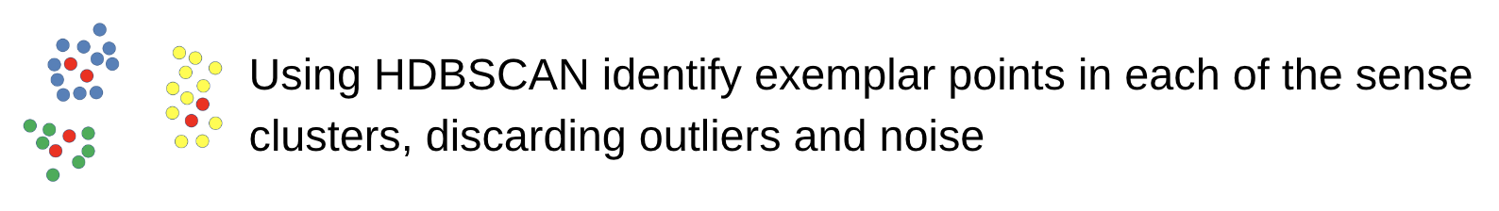
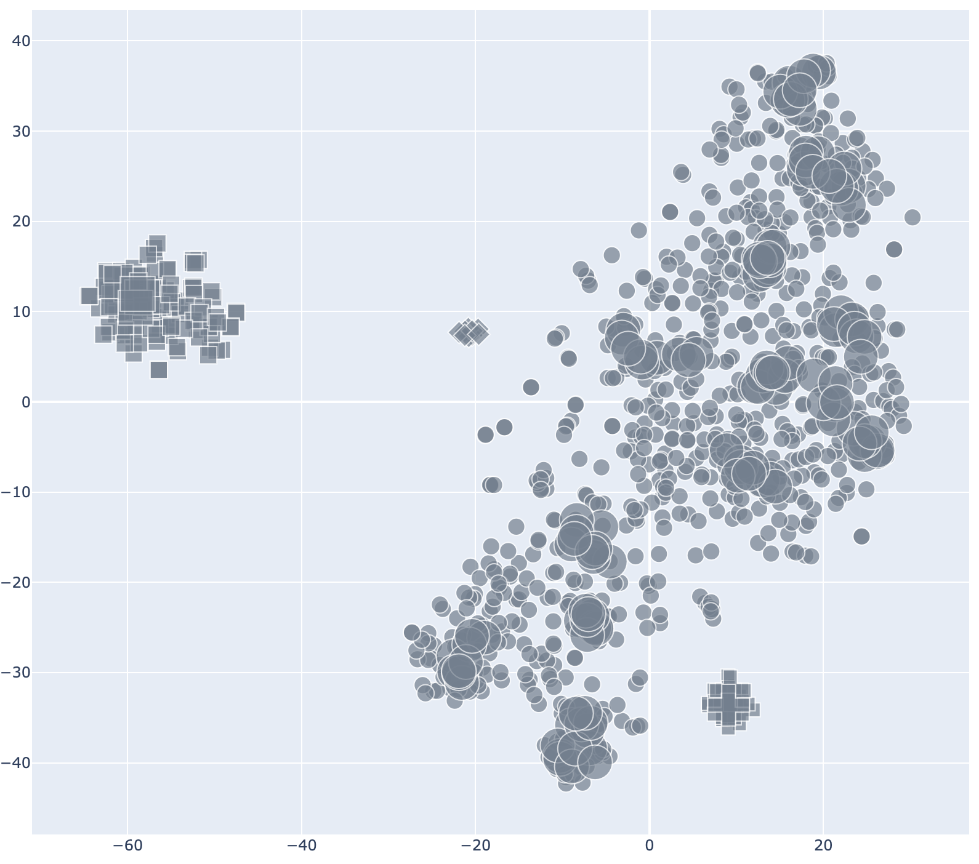
Counting the number of meanings
‘tent’
A feature on the north side of the park, known as The Tent…
The second stage was an air-conditioned tent where…
The party is considered to be something of a big tent party…
Notes:
We use a similar procedure for identifying the number of meanings a word has because analogous as to how a sense is defined as a set of related usages, a meaning can be defined as a set of related senses.
In order to get a different meaning clustering, we must use a different set of points from the one used for sense clustering. We use the HDBSCAN algorithm to identify exemplar points from each of the senses clusters, or those points which persist longest as cluster members during the hierarchical clustering procedure. Loosely, these are those that are most central and best representative of a cluster. In the figure at the right you can see the exemplar points represented by the larger shapes.

Slide 9
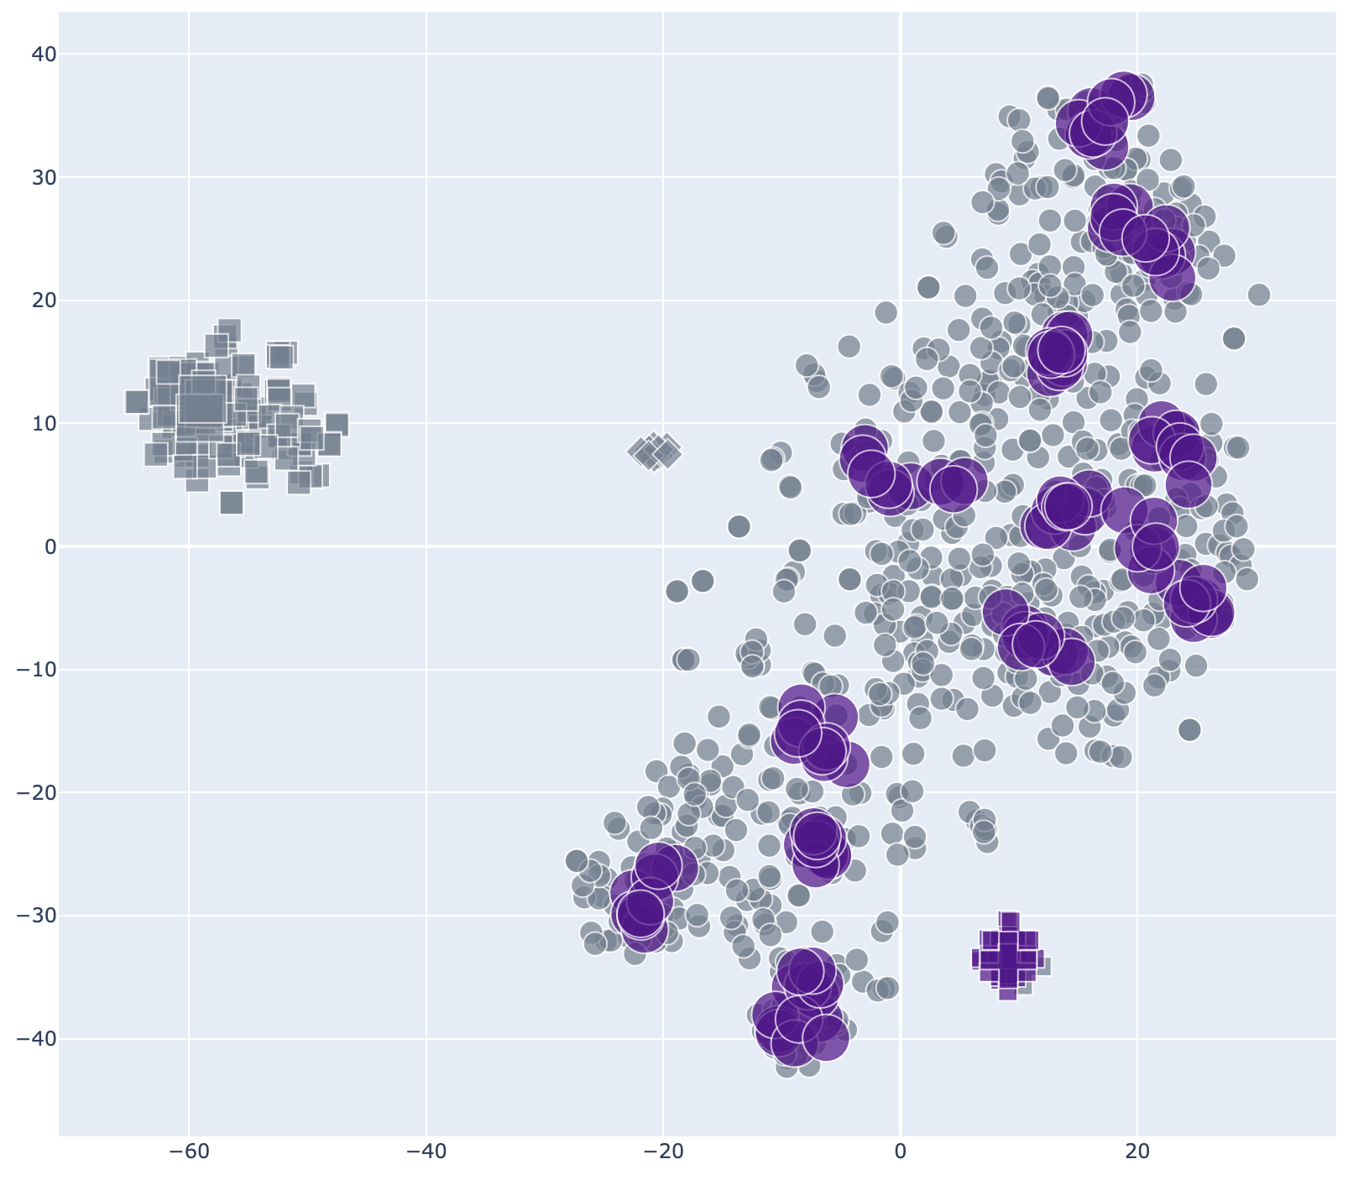
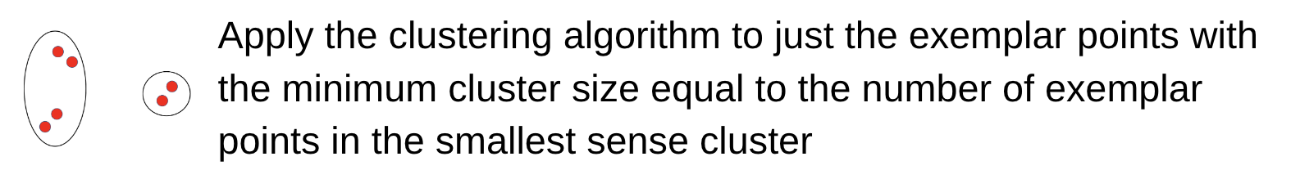
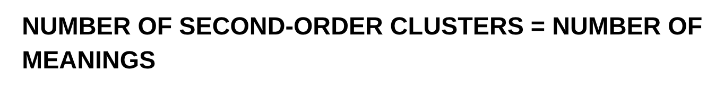


Counting the number of meanings
‘tent’
A feature on the north side of the park, known as The Tent…
The second stage was an air-conditioned tent where…
The party is considered to be something of a big tent party…
Notes:
Once the exemplar points have been identified, we can apply the same clustering algorithm again to just those points to identify any structure amongst the sense clusters themselves. In the figure to the right, we can see that doing this second clustering has joined the structure usage with the metaphorical usage into a single meaning, and identified the proper noun usages as noise and not a separate meaning.
Exactly like the senses, the number of meanings is assumed to be the number of clusters identified from the clustering of the exemplar points.

Slide 10
Q1: How can contextualized word embeddings be used to quantify ambiguity?
Q2: Do our measures perform as well as traditional ones in predicting human behavior?
Notes:
Now that we have identified a method to quantify ambiguities using contextualized word embeddings, we can move on to comparing our measures with those used traditionally in the prediction of human word recognition.

Slide 11
Rodd et al. 2001 [4]
Lexical decision experiment with 124 ambiguous and 58 unambiguous words
Found facilitatory effect for senses and inhibitory effect for meanings
We replicate their experiment using our measures and reaction times from the English Lexicon Project [5]
[4] Jennifer Rodd, Gareth Gaskell, and William Marslen-Wilson. 2002. Making sense of semantic ambiguity: Semantic competition in lexical access. Journal of Memory and Language, 46(2):245–266.
[5] Balota, D.A., Yap, M.J., Cortese, M.J., Hutchison, K.A., Kessler, B., Loftis, B., Neely, J.H., Nelson, D.L., Simpson, G.B., & Treiman, R. (2007). The English Lexicon Project. Behavior Research Methods, 39, 445-459.
Notes:
We compared our measures with those used in an early experiment by Jennifer Rodd and colleagues. The stimuli set contained 124 ambiguous and 58 unambiguous words, and in their results they report a facilitatory effect for number of senses and an inhibitory effect for meanings.
We replicate their study using reaction times and control variables collected from the English Lexicon Project.

Slide 12
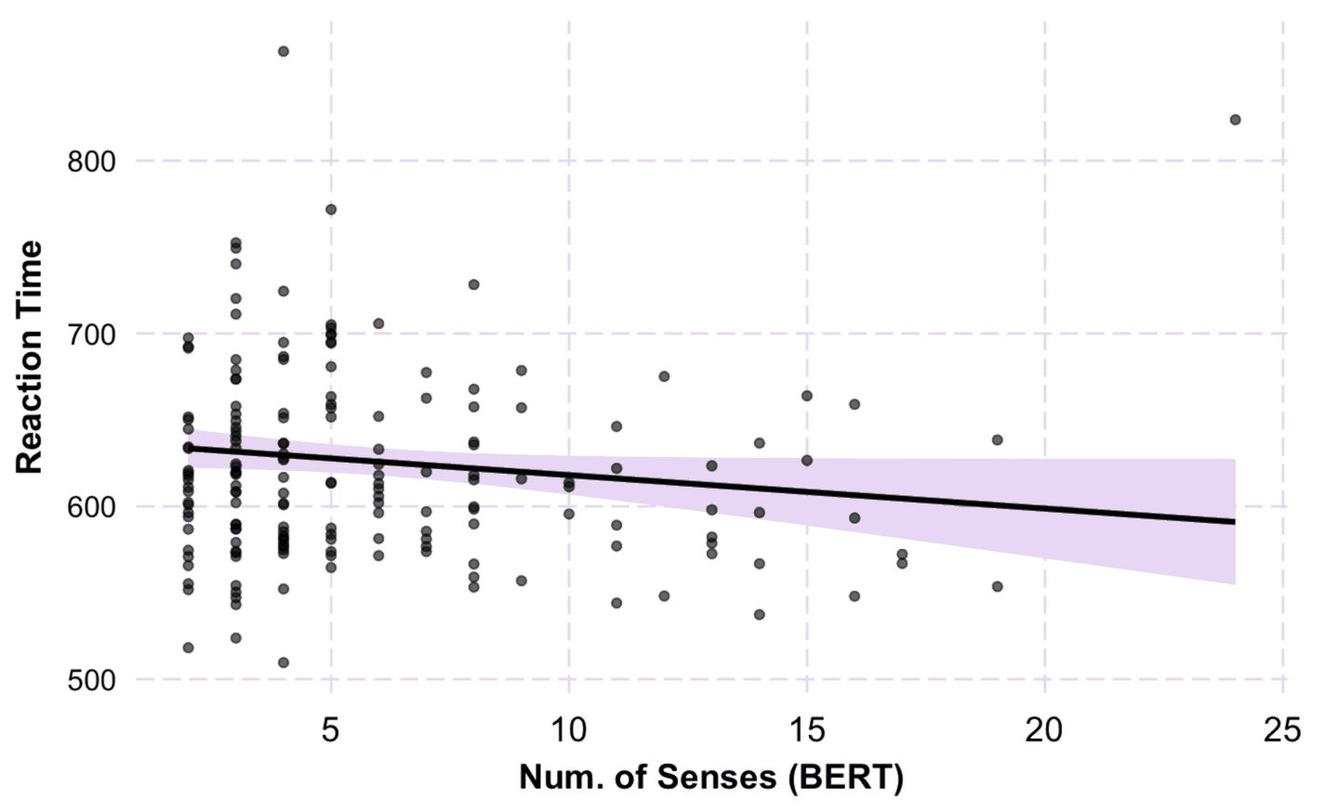
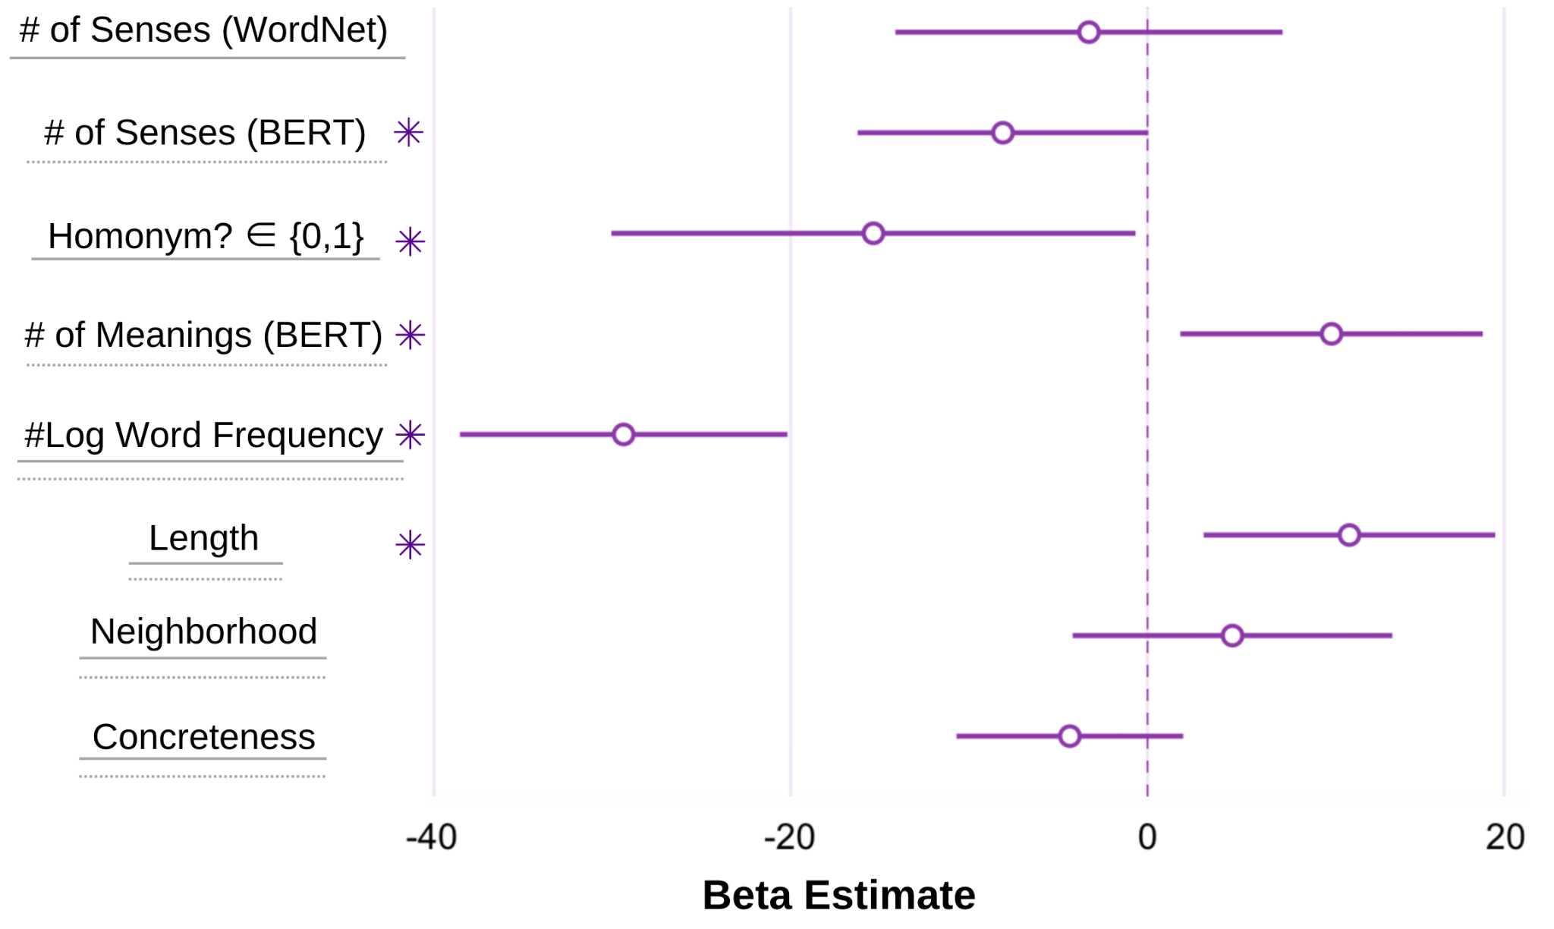

Senses Results
RT ~ # Senses + # Meanings + log Word Frequency + Length + Neighborhood + Concreteness
Model used by Rodd et al. 2001
Model with BERT-derived variables
Notes:
In the figure on the left, you can see a subset of the coefficient results for the model tested. The number of senses as derived from the contextual word embeddings does significantly predict the reaction time, and the effect is facilitatory as can be seen in the figure on the right.
The number of senses as reported in WordNet does not have a significant effect on the reaction time, despite this being the variable used by Rodd in the original experiment.

Slide 13
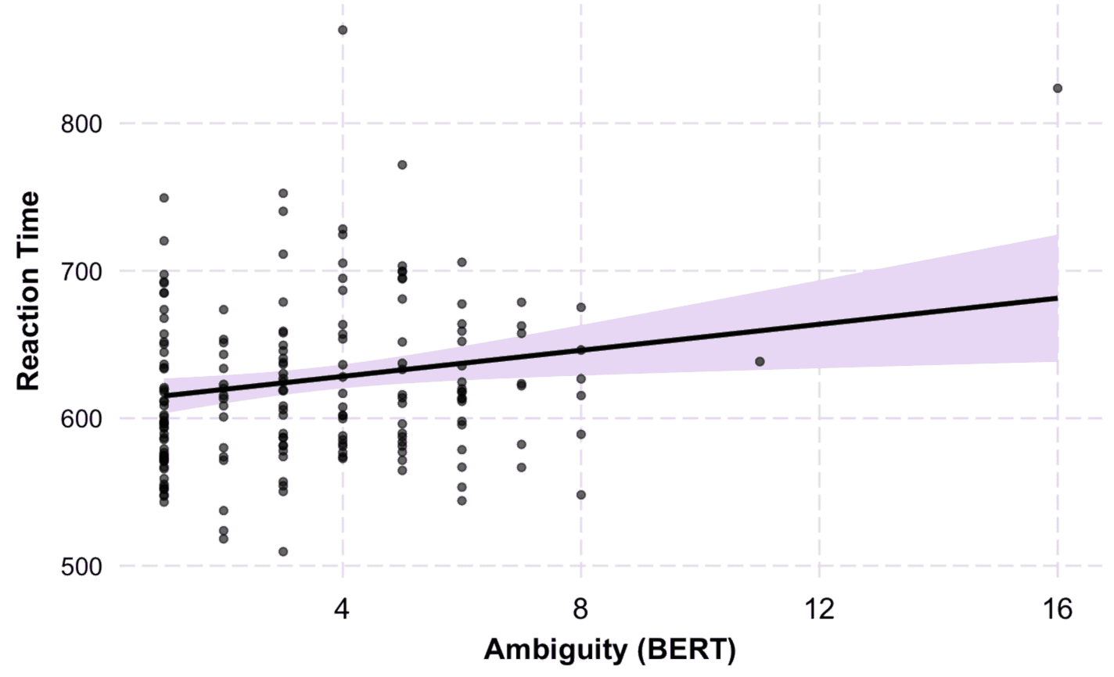
Meanings Results
RT ~ # Senses + # Meanings + log Word Frequency + Length + Neighborhood + Concreteness
Model used by Rodd et al. 2001
Model with BERT-derived variables
Notes:
We see a similar pattern for the number of meanings. The number of meanings as derived from the contextualized embeddings significantly predict reaction time in an inhibitory manner where more meanings correspond to slower responses.
Rodd reported the same result, however when we tried their variable we found the opposite result. This discrepancy does warrant further investigation, but we leave it to future research.

Slide 14
Conclusion
Contextual embeddings contain information about homonymy and polysemy
This information can be used to predict human behavior
Future work can optimize our methodology further and compare it to other measures of ambiguity
Notes:
In conclusion, we have shown how contextualized word embeddings contain information about homonymy and polysemy and how that information can be used for the study of human language processing. We think future work can continue to use our methodology while also investigating how to optimize it further and compare it to additional measures or ambiguity.

Slide 15

Thanks for listening! Questions?
This research was supported by the NYUAD Research Institute under Grant G1001 and was carried out on the High Performance Computing resources at New York University Abu Dhabi. We additionally thank Tal Linzen and anonymous reviewers for their guidance and feedback on earlier versions of this paper.
Code and Slides
Notes:
Thank you so much for your attention and now I am happy to take any questions!

